Slide 1



Ghulam Ishaq Khan Institute
Cluster
Wiz
Object Oriented
Semester Project
by: Rayyan Salman & Asad Shayan

Slide 2
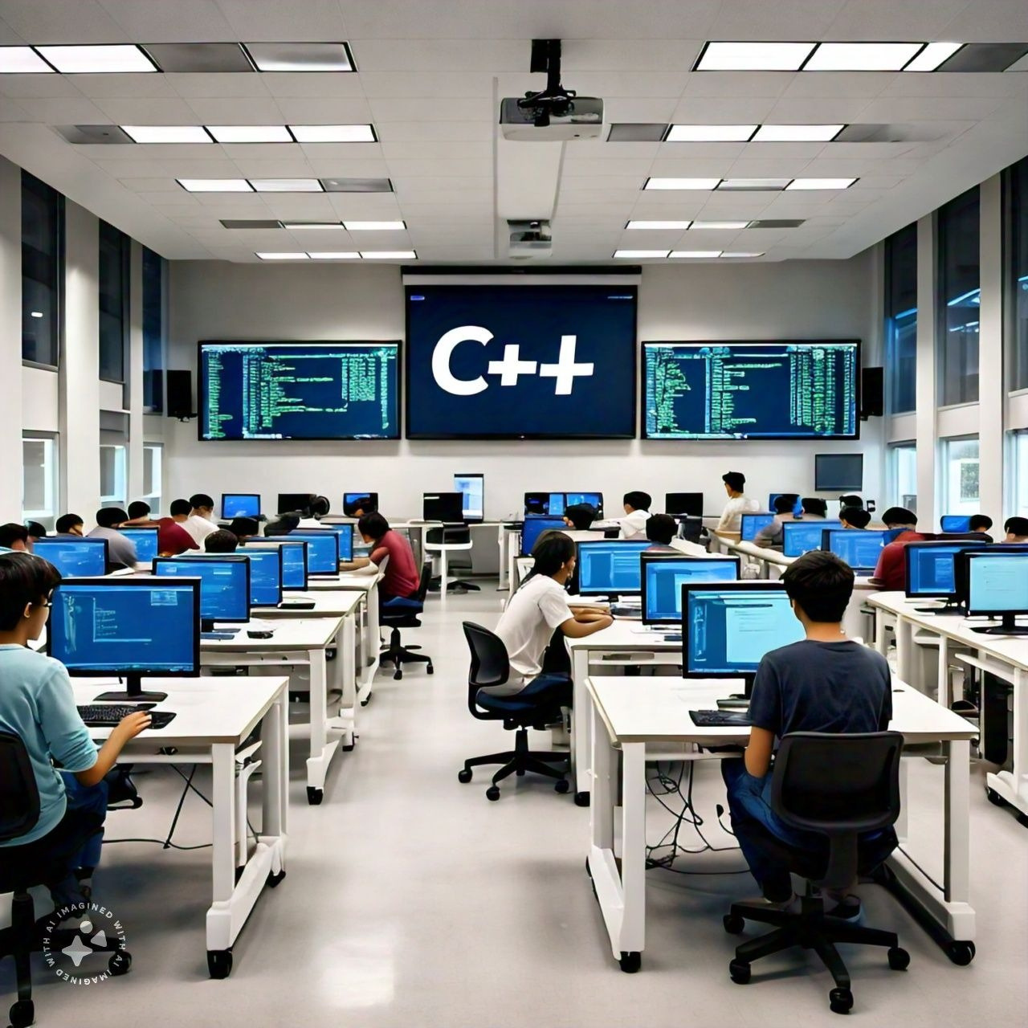





LANGUAGES & TOOLS
C++
VS CODE
VISUAL STUDIO
Cluster
Wiz

Slide 3





WHAT IS CLUSTERING ?
Clustering groups similar data points together based on their attributes, uncovering patterns and structures in datasets
It is an unsupervised learning technique used in various fields like image processing and market research
Cluster
Wiz

Slide 4

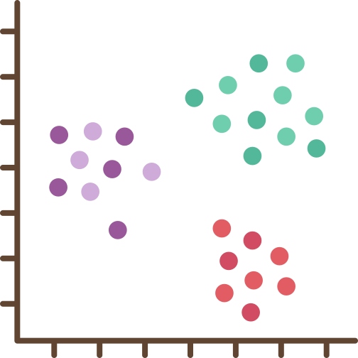

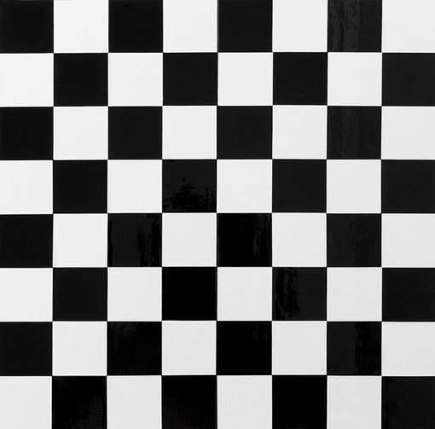
FUNCTIONALITY
Clustering
Engaging GUI
Bitmap Visualization
This functionality uses unsupervised machine learning to identify patterns and cluster data points effectively
Our project features a highly interactive and user-friendly graphical user interface (GUI) designed to ensure seamless navigation and an engaging user experience.
Visualize data from various matrices through clear, detailed bitmap images for enhanced data analysis and interpretation
Cluster
Wiz

Slide 5

INSTRUCTIONS
Create Corelation
Matrix
Create
Discrete
Matrix
Attach
File
Permutate
&
Cluster
View
Bitmap
Repeat
Cluster
Wiz

Slide 6


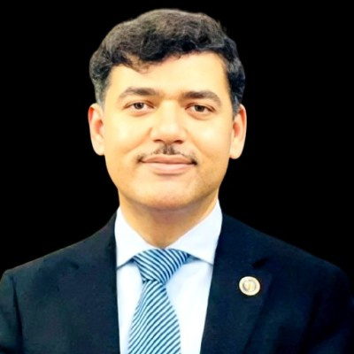
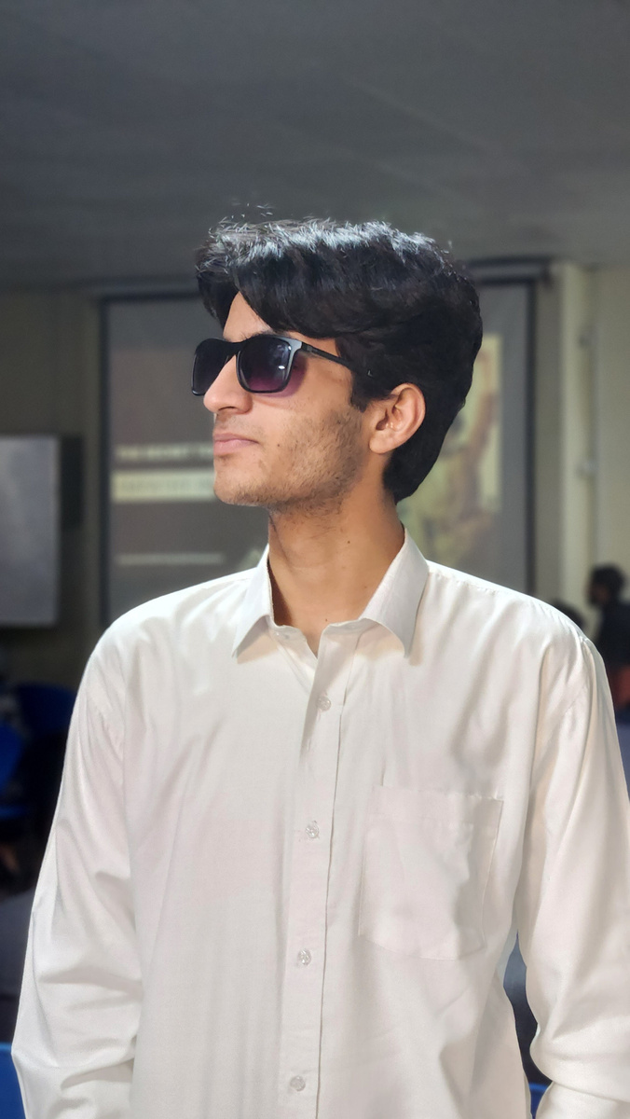

OBJECT ORIENTED Programming
CS-112
Prof.Dr.
Zahid Halim
Asad
Shayan
Rayyan
Salman
Course Instructor
GUI Dev
Backend Dev
Cluster
Wiz

Slide 7
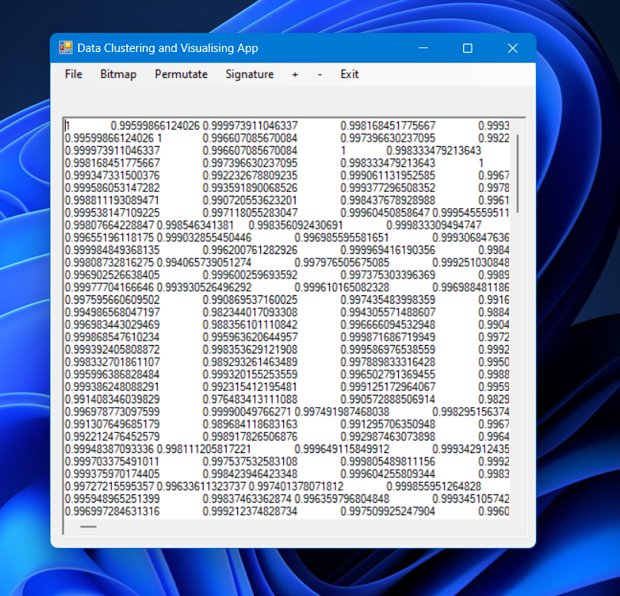
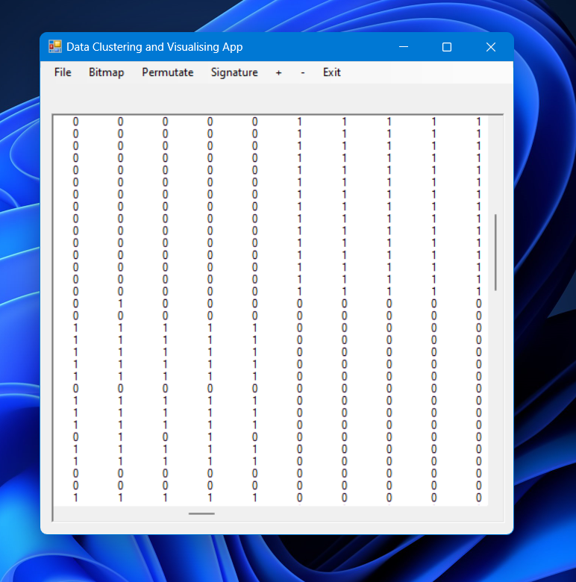
CORRELATION MATRIX & DISCRETE MATRIX
Cluster
Wiz

Slide 8

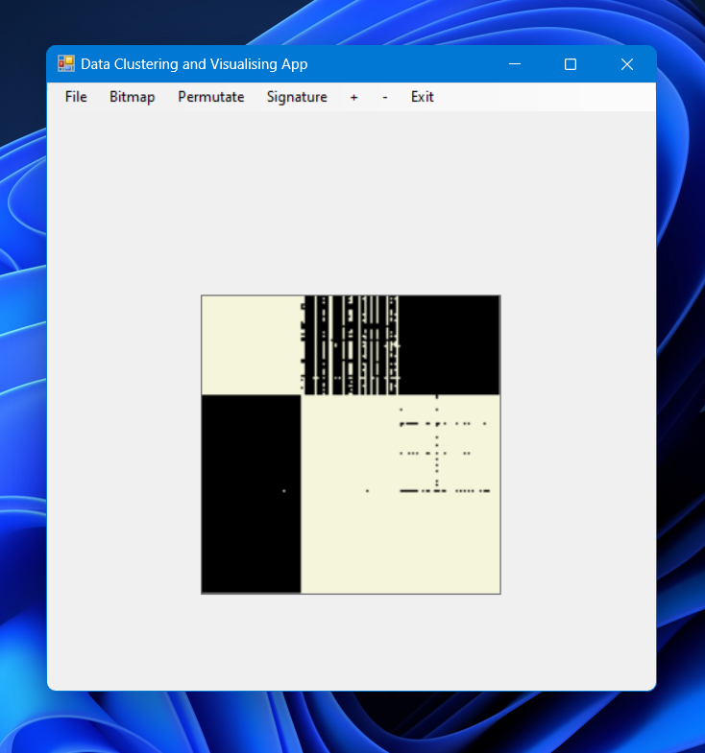
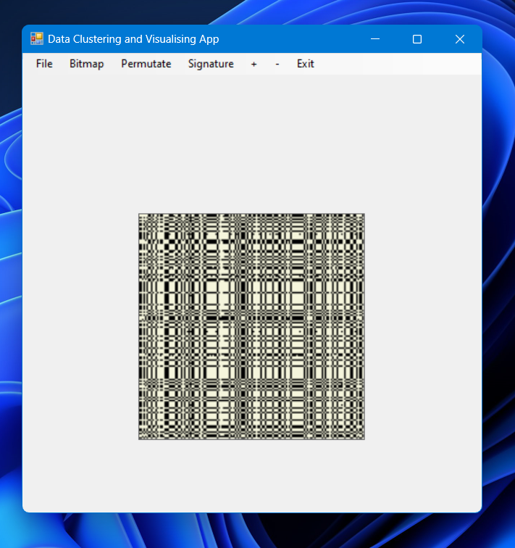
BINARY BITMAP & PERMUTATED BINARY BITMAP
Cluster
Wiz

